Slide 1
Valet Advanced
Why, What and How

Slide 2


Slide 3
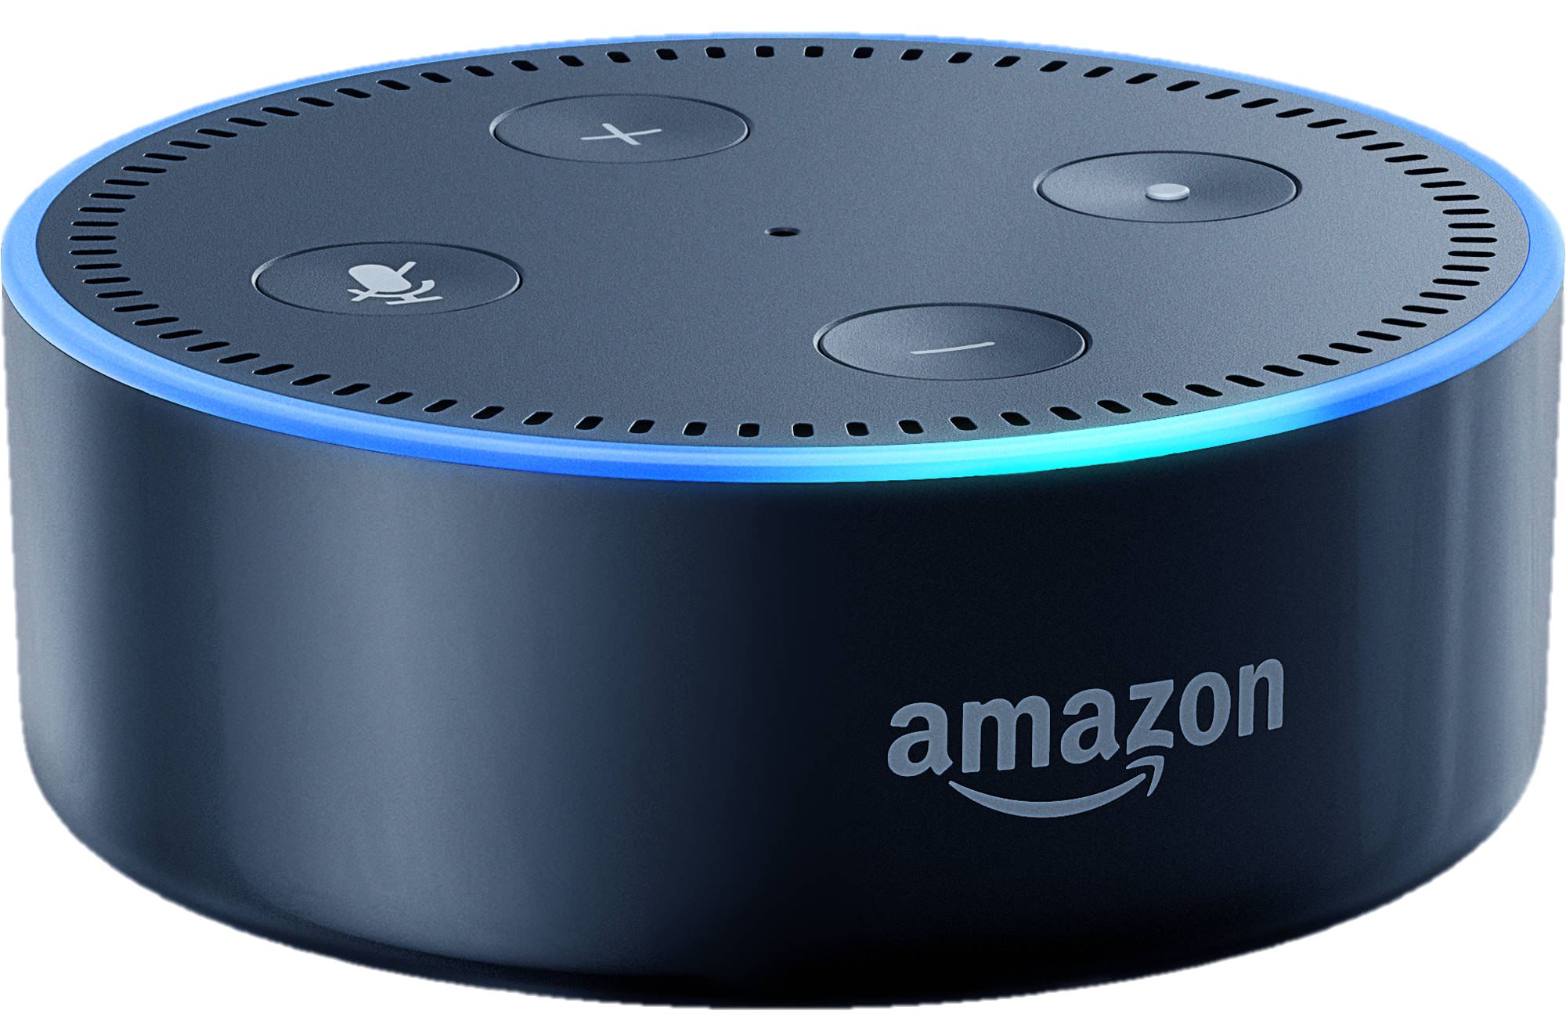
Why Valet?
Jeff Bezos
“To date over 38 million DOTs have been sold.”
”Can you integrate Alexa into our system?”
Customers are already asking
Would you like to make money doing it?
Improve the customer experience
Notes:
There is money to be made utilizing an incredibly popular product that by itself has no profit potential. Let me give you a few reasons why this technology can benefit you and your company. Over 30 million Echo DOTs have already been purchased. ”Can you integrate Alexa into our system?” has become a common request from homeowners. Taking advantage of the current install base is a no-brainer. Not only can you do it, but you can open up other sales opportunities in the process. All of this while enhancing your customer’s existence.

Slide 4
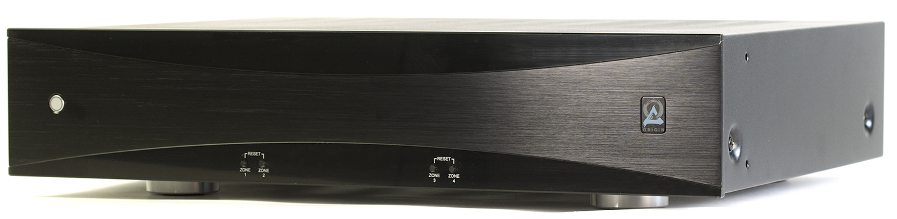
The Purpose of Valet
Enhance the music experience in the home
Provide a simple yet powerful solution
Easy to explain
Easy to design
Easy to install
Easy to use
Take advantage of a massively popular category
Voice control
Amazon Echo DOT
Create profit opportunities
Amplification
Speakers
Future expansion
Notes:
Why did we create this system? First and foremost, we are a music company. We exist to fill homes with high-fidelity music that enhances the lives of people who live there.
Many companies create complex products that attempt to do everything. The ability to simplify a system benefits everyone in the chain, the salesperson that presents it, the designer who lays it out, the technician who installs it and the homeowner who uses it.
The ability to simplify the system is based on a category that has just recently become incredibly popular. Voice controlled operation, and specifically the Amazon Echo DOT allows us to create a user experience that is both efficient and exciting. The mere operation of the system is fun and entertaining.
However, in spite of the fact that over 30 million DOTs have already been sold, the CI category has had very little opportunity to financially benefit from the technology. Now, by attaching amplification and loudspeakers directly to the DOT, the system can be cutting edge AND profitable.
Beyond the basic system, because of the myriad of skills already available for the DOT, future expansion into the control of any number of subsystems is already available.

Slide 5

Music First
Simple and elegant music distribution
Multi-channel amplification
4 stereo zones
50wpc
Selection of individual source/streaming service per zone
Native streaming services on the DOT
Spotify
Pandora
TuneIn
iHeart Radio
Sirius XM
Deezer
Amazon Music
Notes:
Let me describe the system. The AV850 Valet amplifier is an 8 channel, four zone amplifier with 50 watts per channel. A different source can be simultaneously selected in each zone. These include the streaming services that reside natively on the DOT itself. They currently include Spotify, Pandora, TuneIn, iHeart Radio, Sirius XM, Deezer and Amazon Music.

Slide 6

Music First
External Sources
Individual zone inputs
Global inputs
Selectable by zone
Automatic muting and switching for DOT to external source
Incredible improvement in audio fidelity
Notes:
In addition, Valet has inputs for external sources that the user wants to play through the same loudspeakers. These could include television audio or other music sources.
These sources can be connected to a single zone or through a global input that can be preselected for multiple zones.
If the user is listening to an external source and Alexa is addressed, a patent pending muting circuit automatically mutes the external source and allows Alexa to respond through the speakers. Once the interaction is completed, Valet will automatically return to the external source.
If streaming music directly from the DOT is selected, Valet will default to that input until it is no longer playing in which case it will switch back to the external source. All of this switching takes place without any action required by the user.
The tiny speaker in the DOT itself is a substantial sonic performance restriction. By amplifying the signal from the DOT and playing it through high-quality loudspeakers, the musical experience is dramatically enhanced. It is also surprising to hear Alexa’s voice through real loudspeakers, She sounds like an actual person standing in the room.

Slide 7
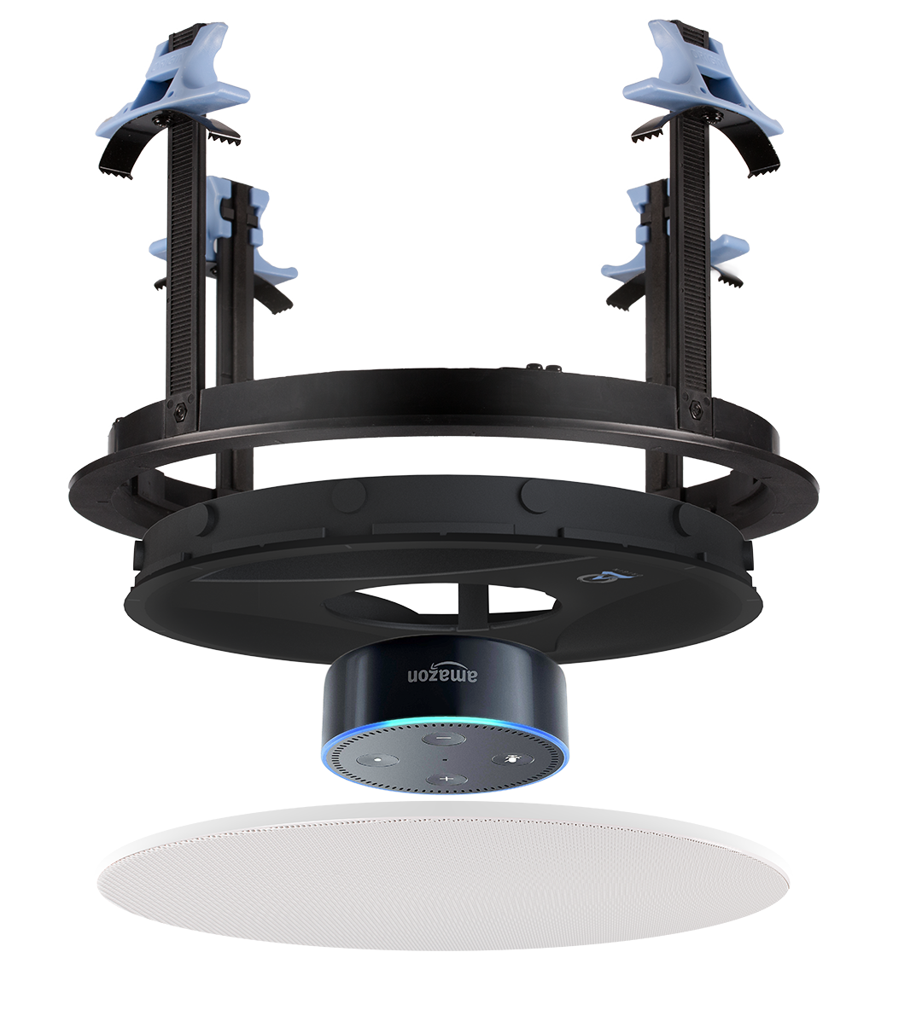
Discreet Installation
In-ceiling mount
DOT hidden behind a speaker grille
Tool less mounting system
5”, 6/8” and 10”
In-wall mount
June 2018
Retro opportunities
Existing keypad systems
Notes:
Instead of leaving the DOT on a shelf or counter top, it can be placed out of site in the ceiling. Hidden behind a speaker grill we literally achieve the Jarvis/Ironman experience. It’s available in 5”, 6/8” and 10” versions to match the speakers in the room. A wall mount version will be available soon and will allow you to replace older existing keypad systems that are already wired with CAT5 cable. Simply replace the keypad with a DOT and you instantly transform it into the latest technology. Walk into a room and give a verbal command and Alexa instantly responds with your music of choice, or the news, weather forecast, sports scores or any number of different automation possibilities. To the end user, this is now a critical piece of the home of the future.

Slide 8
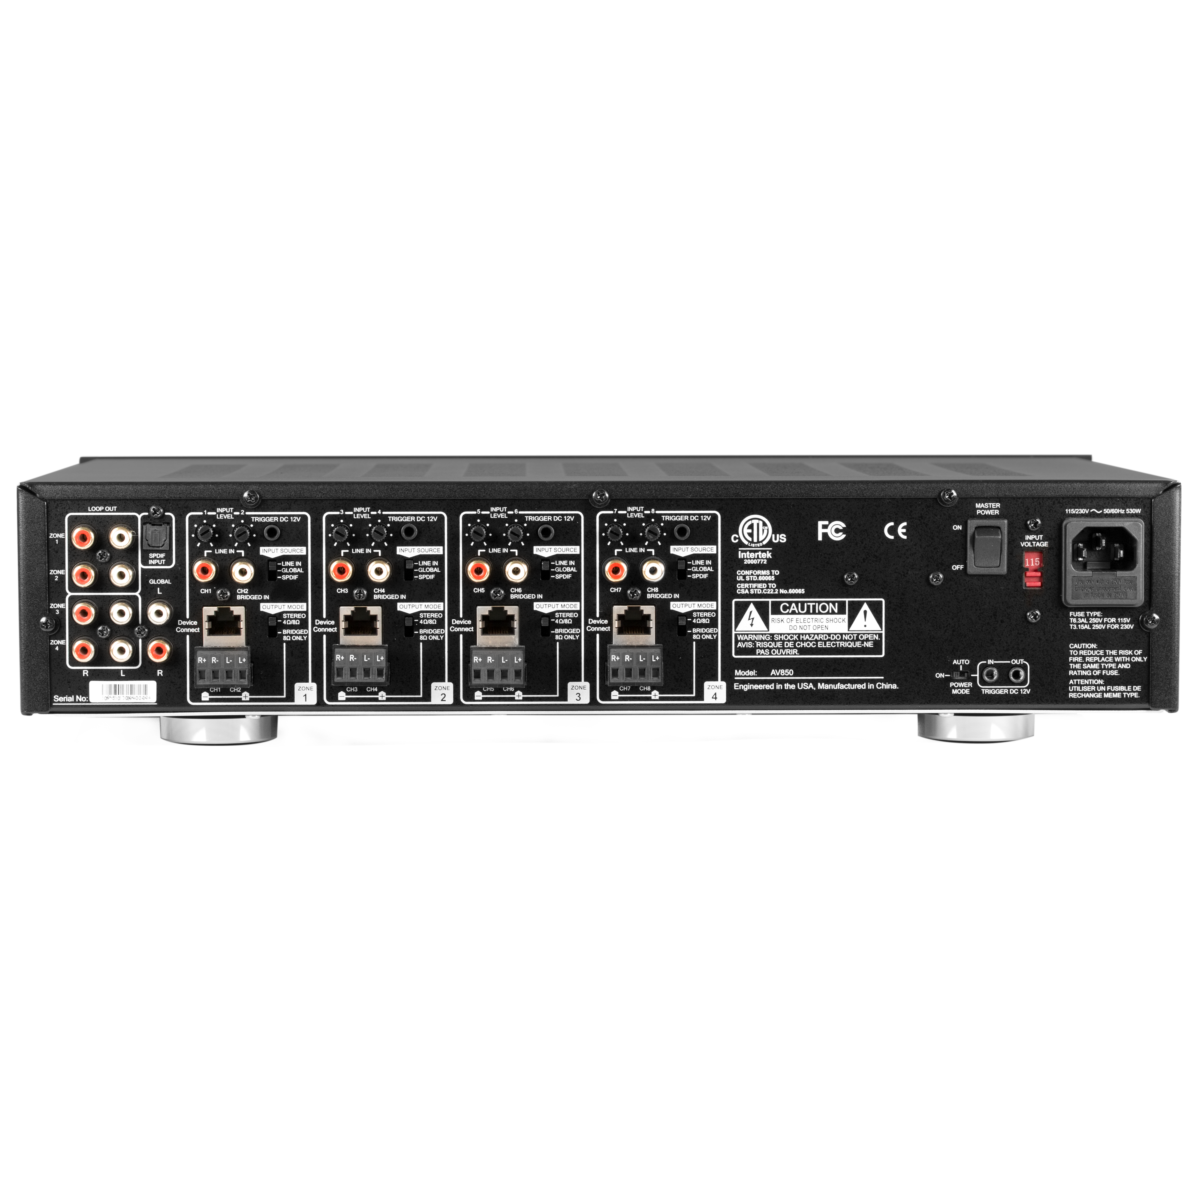
The Back Panel
Notes:
Let me go through the various connections on the back panel. We begin with the individual zone connections.

Slide 9
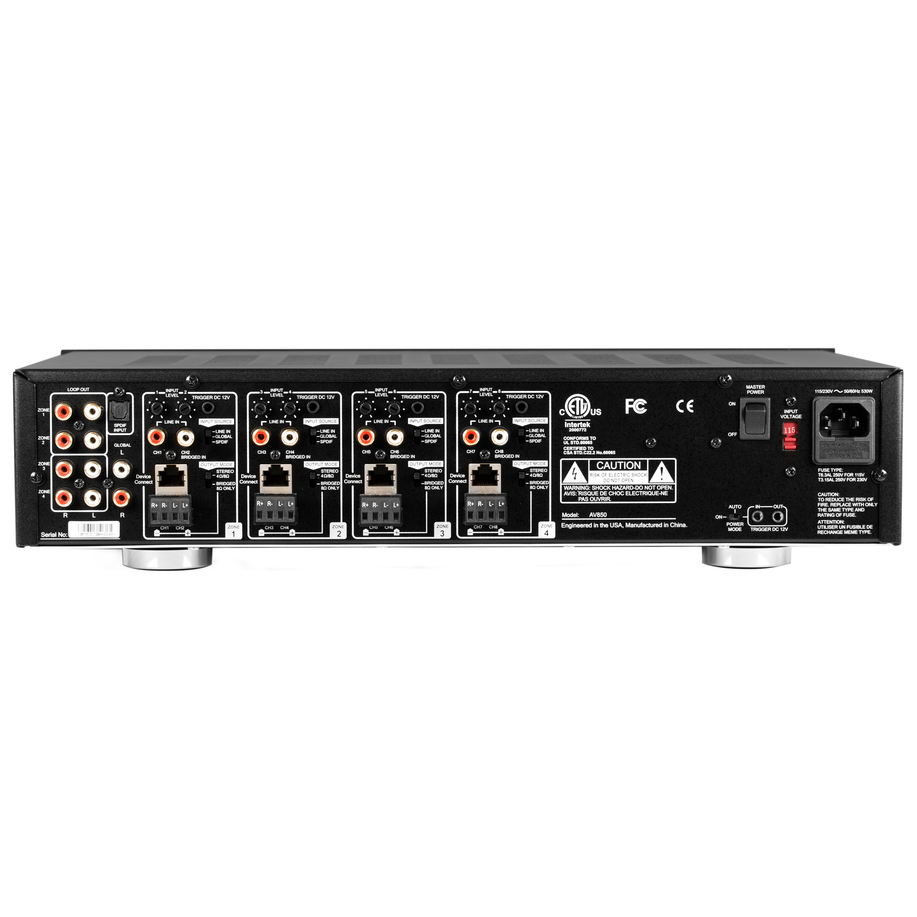
Zone Detail
Notes:
Each of the four zones are identical. The speakers are wired to a standard Phoenix connector. This can be done either as left and right in a stereo pair, or bridged for applications that require more power. Bridged mode requires that the output mode switch be set to “bridged” and the nominal impedance of the speaker connection remain at 8 ohms. Next we see the RJ45 jack that accepts either CAT5 or 6 and connects to the DOT via the proprietary balun. Here are the individual zone, analog, line level inputs. Note that the bridged input is on the channel 2 input. Next to those is the switch that determines which input will be active when the DOT is inactive. Here are the input level controls that allow for level adjustments that affect both the DOT input and the external source plugged into the line in. To avoid a startling spike in volume when the Valet switches sources from the DOT to an external source by adjusting the output on the DOT and/or the external source. Finally we have the 12-volt trigger via a standard 3.5 mil jack. This contact closes whenever the DOT is active, be it during conversation with Alexa or when music is streaming through the DOT.

Slide 10
The Back Panel
Notes:
Here we review the Loop and Global connections.

Slide 11
Loops and Global
Notes:
There is a line level output for each individual zone. These can be used, for example, to connect to an external amplifier when more power is required or to a subwoofer dedicated to that zone. The global inputs are divided into analog and optical (digital) via SPDIF. The input source switch mentioned in the individual zone description will determine if the global input will be the default source in that zone and, if so, which of the two global inputs will be active.

Slide 12
The Back Panel
Notes:
Here we see the A/C power options available.

Slide 13
Power Options
X
X
X
Notes:
A slide switch selects one of three options. Either power activated by a 12-volt trigger, or by sensing audio signal, indicated here by the “AUTO” position, or simply in the permanently “ON” position. It is recommended that this switch remain in the ”ON” position as turning off the Valet results in power to the DOTs being disconnected. This will result in a substantial delay when the system is again fired up as the DOTs will be forced to power-cycle and reconnect to the WiFi network. This could take a full minute or more, a delay that can be quite annoying to the person attempting to operate the system. There is one scenario where the 12-volt trigger input is a preferred solution. In areas where power failures are common it becomes necessary to manually restart the Valet using the power switch on the front panel. This can be avoided by plugging a 12-volt power supply into a local A/C outlet and plugging it into the “12v In.” When the power returns to the home, the 12-volt power supply will become active and trigger the Valet to restart without the necessity of pressing the front panel button.

Slide 14
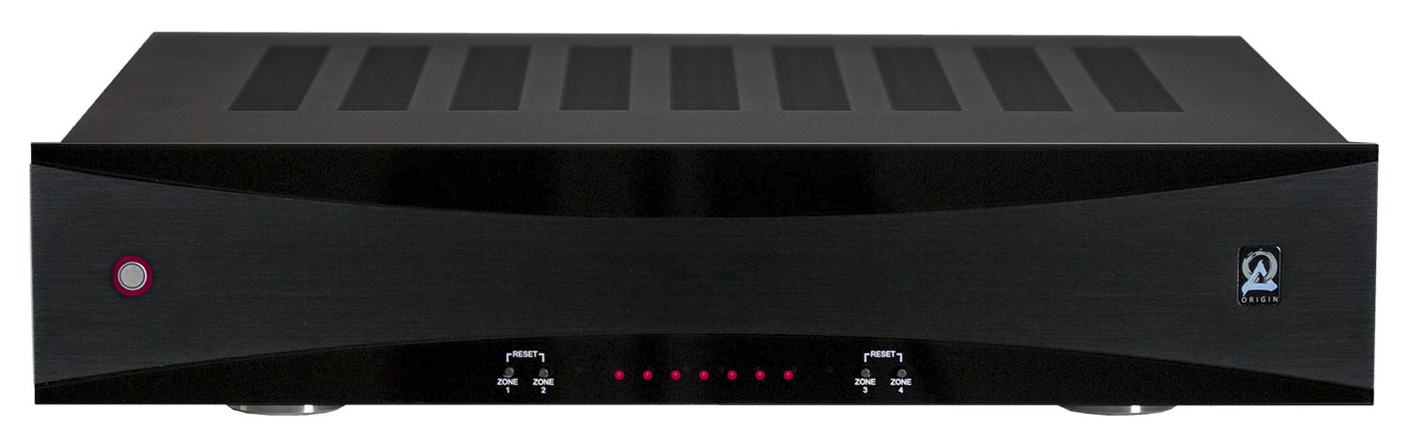
Front Panel in Operation
Notes:
As to the actual front panel, besides the power switch, there are also indicator lights that flash red upon startup and then turn blue for normal operation. Should there be a fault or short in one of the channels, it will be indicated by one or more of the lights turning red..

Slide 15
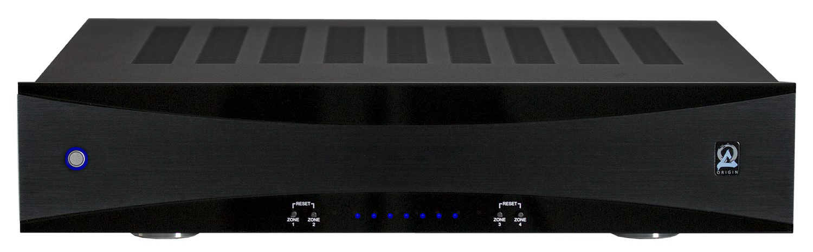
Front Panel in Operation
Notes:
Should one of the DOTs have a problem in operation or with its Wi-Fi connection, a simple power cycle will almost always correct it. This is accomplished by pressing the button for the respective zone on the front panel. No need to access the DOT in the ceiling or unplug the CAT5/6 cable from the rear of the unit. A simple button press is all that is necessary. It will take the DOT approximately a minute to reset.

Slide 16
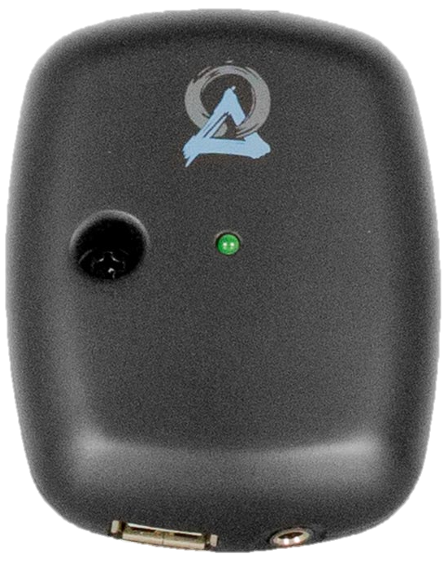
The Balun
To/From Amplifier
To/From Dot
Notes:
The DOT is connected to the Valet via a proprietary balun. One side connects to the Valet and the other side connects to the DOT.

Slide 17
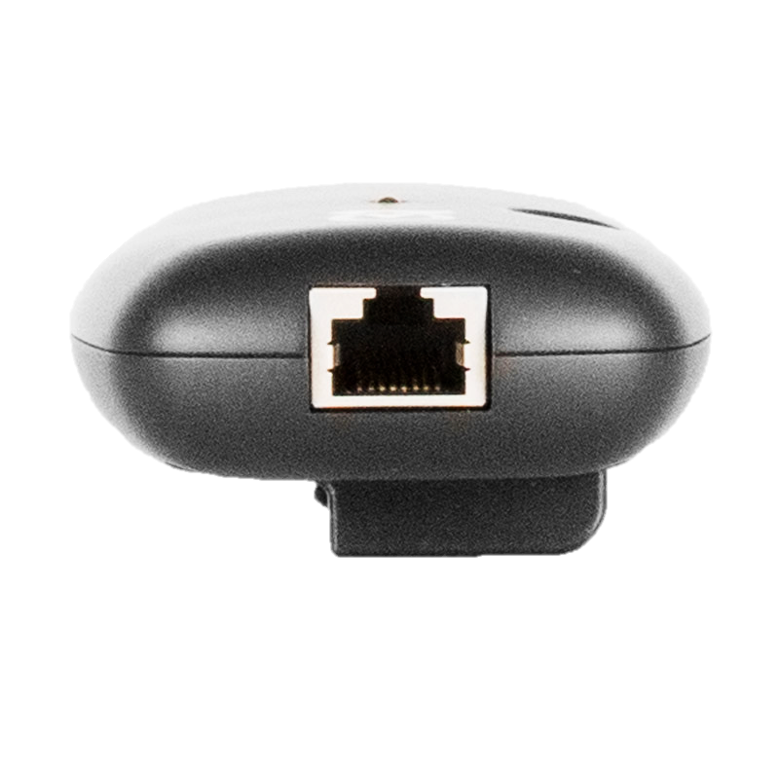
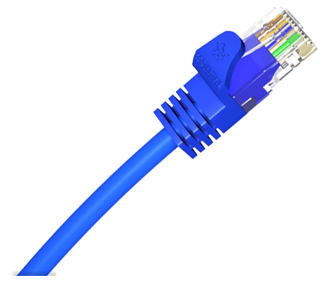
The Balun
CAT6 cable connected to Amplifier
Notes:
The Valet is connected via a standard Cat5/6 cable. CAT6 will allow for a longer run than CAT5.

Slide 18
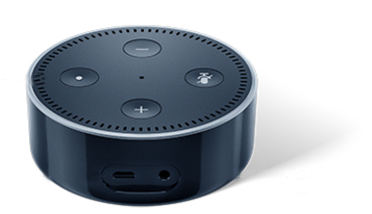
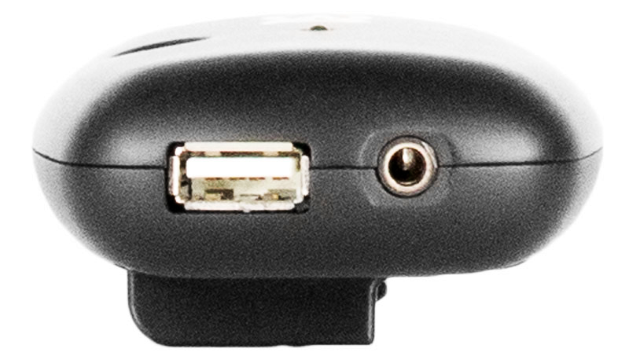
The Balun
USB to USB Micro for Dot Power
3.5 mil TRS for Audio Return
Notes:
The balun divides the connection into two functions. One is a USB to Micro USB that provides power for the DOT’s operation. The other is a 3.5 mil aux cable that converts the DOT’s audio output into a balanced connection allowing it to travel back to the Valet without any noise being injected into the system. Both of these connections are terminated inside the Valet unit itself so no balun is needed on that end.
Be aware that the power protocol for the Valet/DOT interface through the balun is proprietary. It is USBOC (USB Over Category Cable) not POE or POE+. Attempting to connect using standard POE will damage the system.

Slide 19
System Design With DOTs as Only Source
AV850 Valet Amplifier
Four Echo DOTs
Connected through four home-run CAT5 or CAT6 connections
Balun in the remote room
Power
Audio return
4 RJ45 connections on back of amplifier
5 pair of speakers
Standard speaker wire
Notes:
Let’s look at a typical system design with the Valet amplifier. We will layout four zones with an Echo DOT in each zone and 5 pair of speakers.

Slide 20
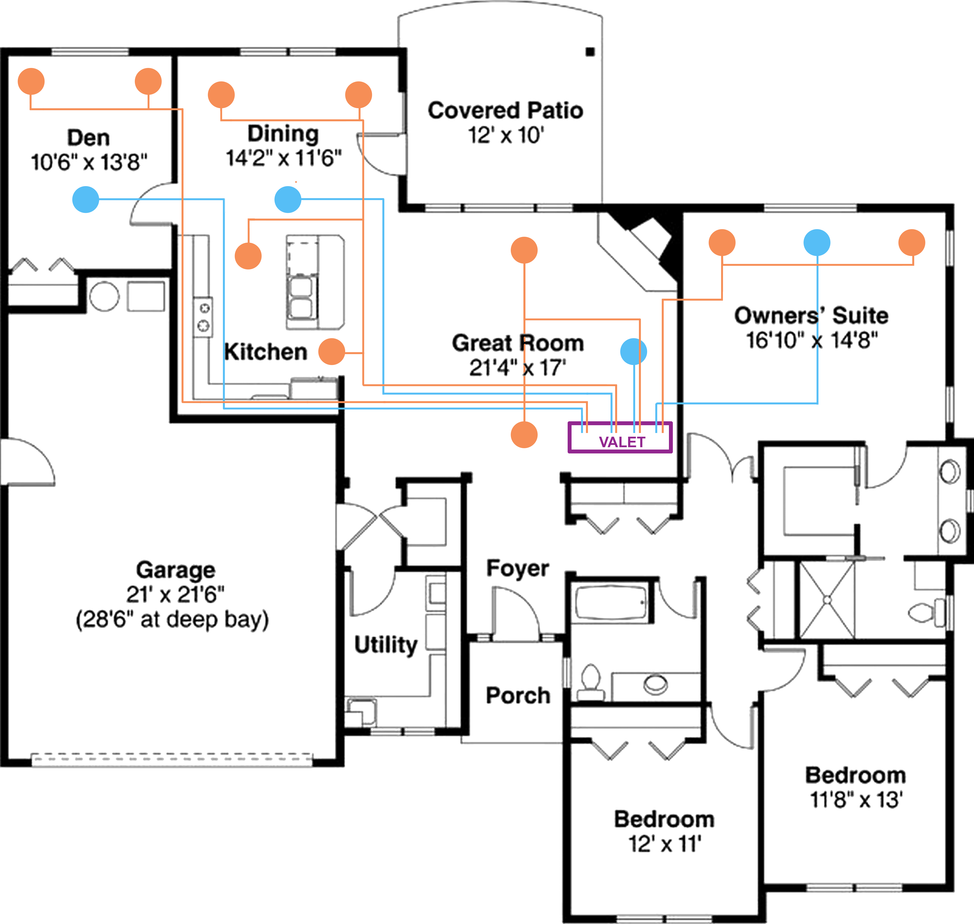
Basic System
Notes:
Here we see a typical home with four zones. A DOT is mounted in each zone here color coded in blue. Color coded here in orange are two speakers to be installed in three of the rooms with four speakers in the Dining/Kitchen area. The two Dining/Kitchen pair will share the same DOT.
Since each DOT can be used as a streaming audio source when connected to the Wi-Fi network, this simple design now constitutes a complete four zone, multi source audio system.

Slide 21
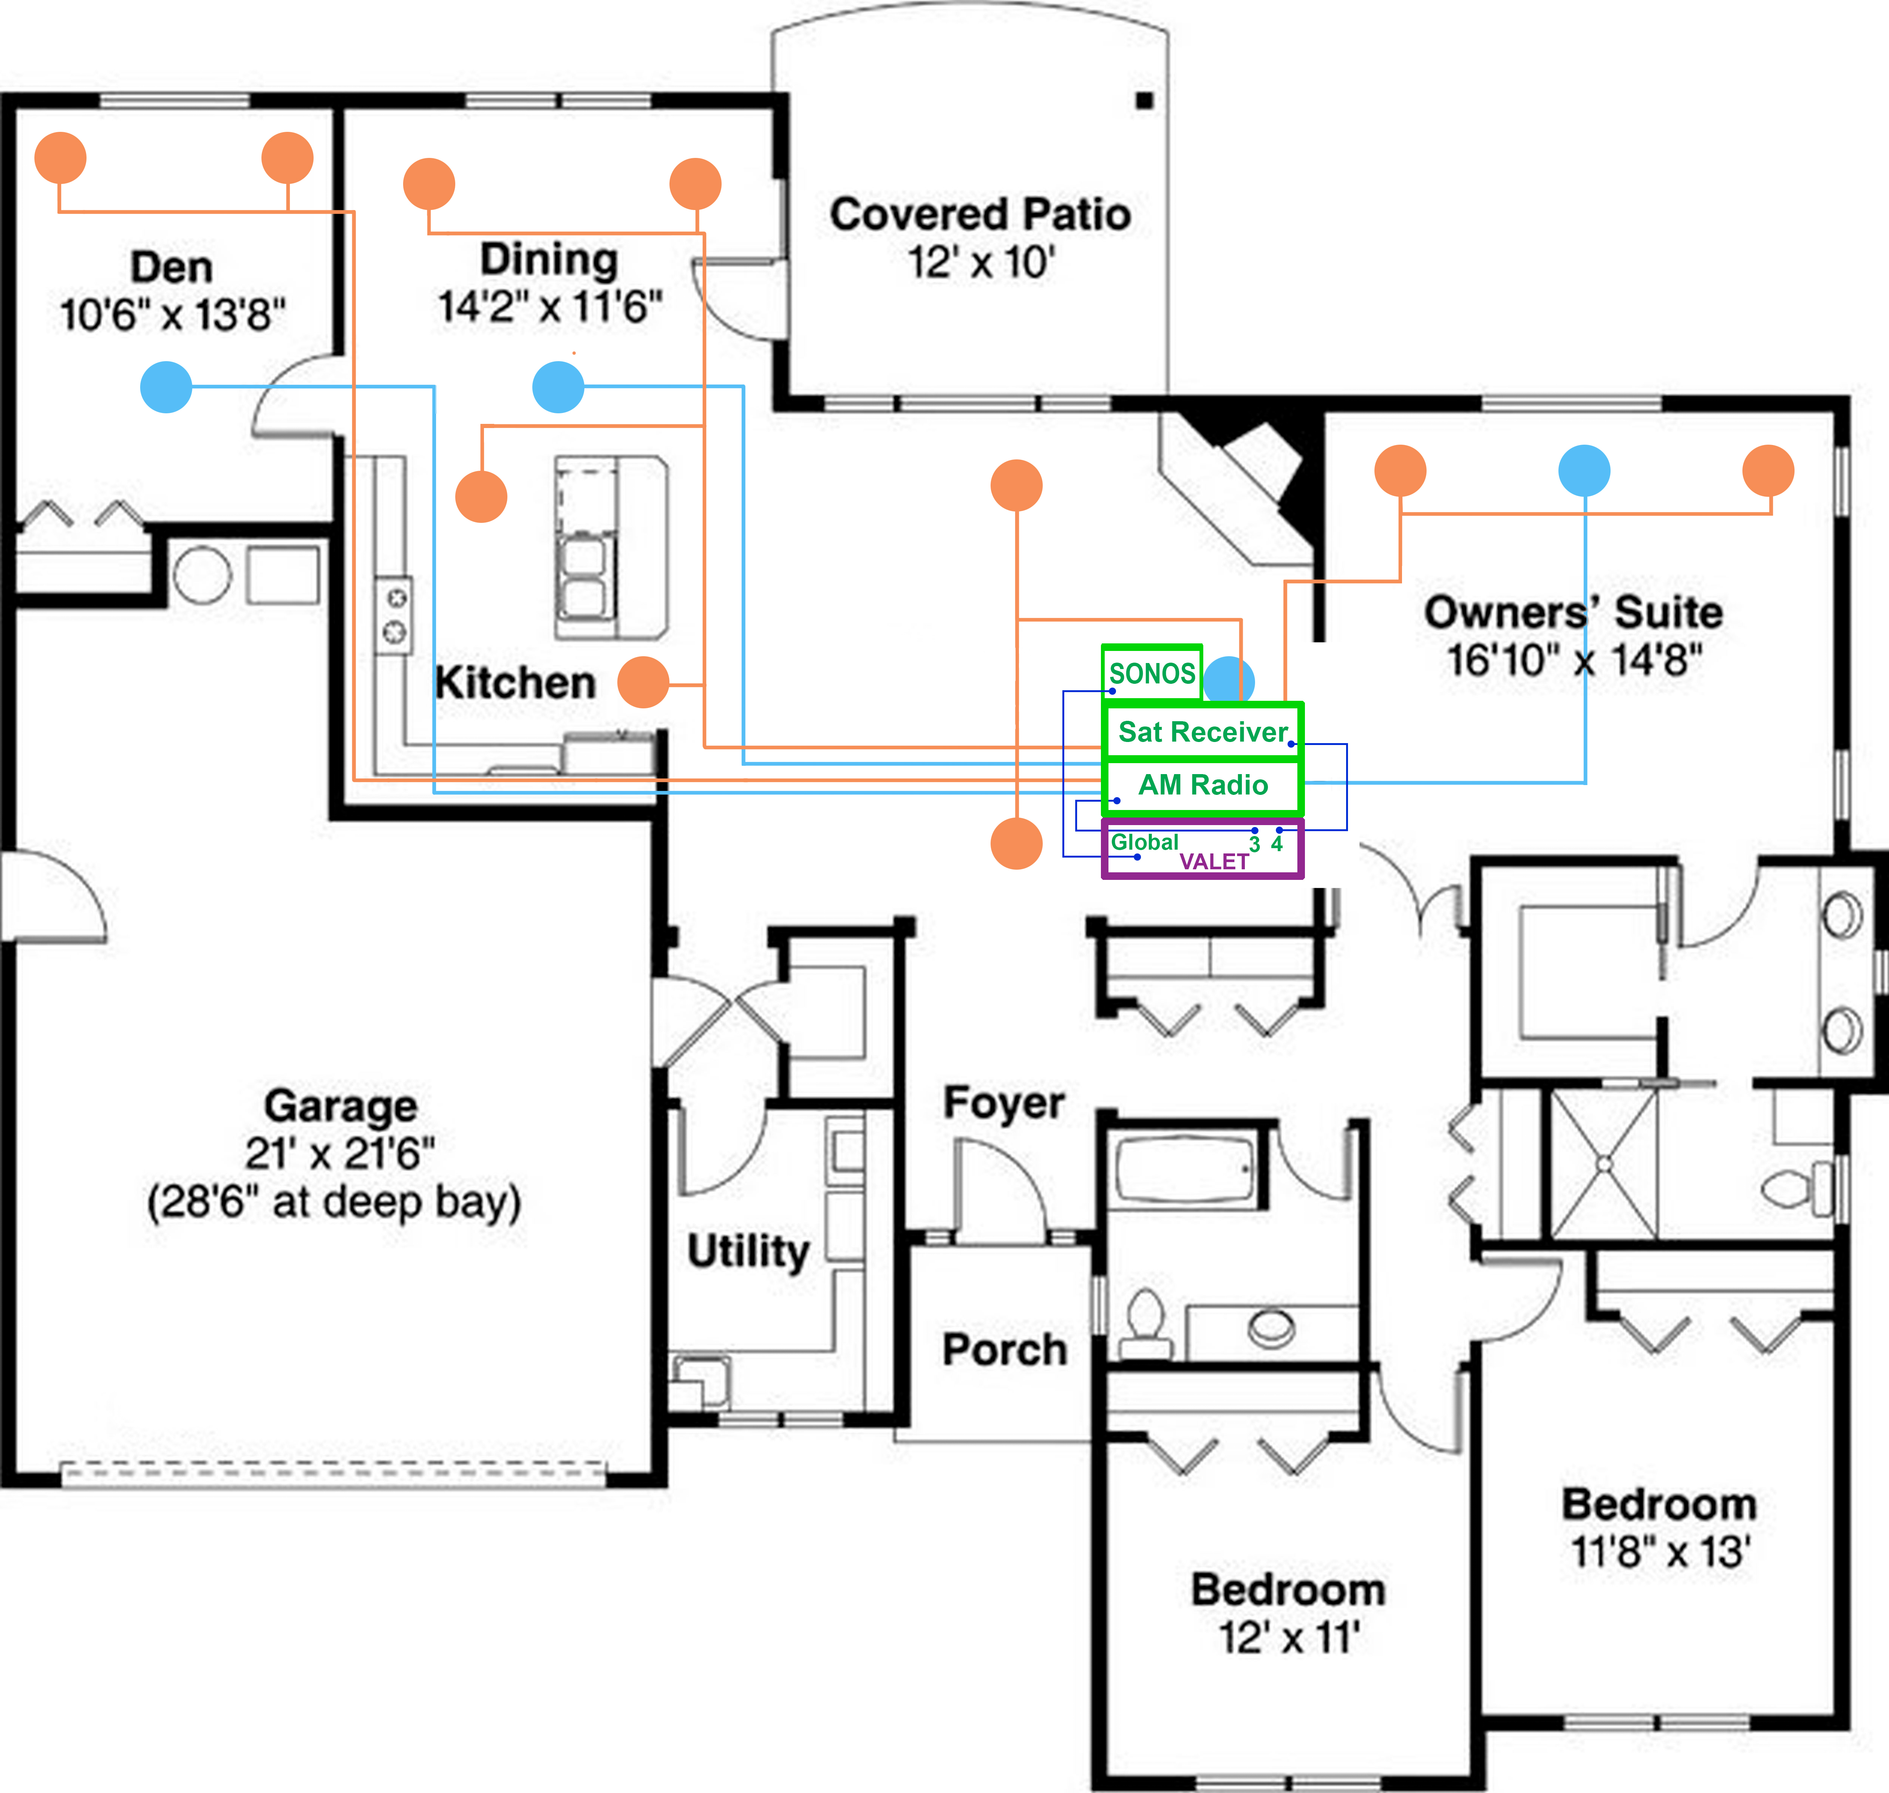
Intermediate System
Great Room
21’ 4” x 17’
Notes:
Stepping up, we can add external sources to the system. The audio from these sources can be connected to either the analog inputs in an individual zone or to the analog or SPDIF optical connection in the Global section. A three position slide switch is located in each zone section on the back of the AV850. The input choice is either the individual zone input, the Global analog input or the Global SPDIF optical input. This allows each zone to preselect the source to which it will default when the DOT is not actively playing music or responding to a command. If the external source is not playing at the time, instructing Alexa to stop playback will result in silence in that zone.
In this example we have added AM Radio as an individual source for Dad’s office which is located in the den in zone 3 as he is old school and likes to access his news station. We have also added the Satellite TV receiver as an audio source in the master suite in zone 4. We finish up by adding a SONOS Connect to the global input and we have selected that global source for the great room and the kitchen/dining rooms in zones 1 and 2.

Slide 22
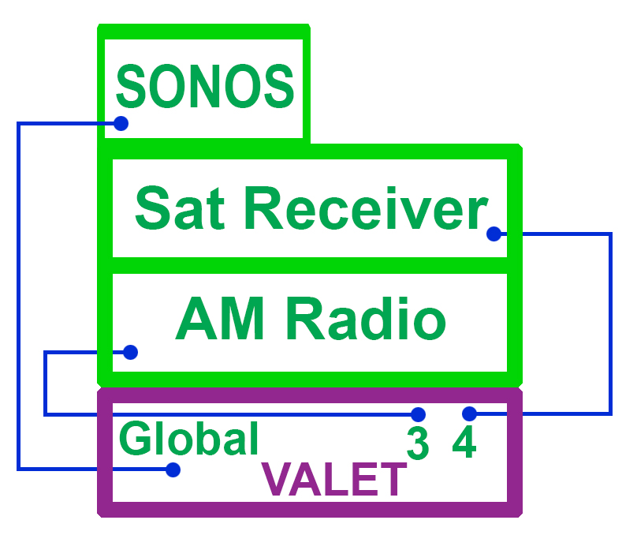
Intermediate System
Notes:
Again, the connections are very straightforward with the Sat Receiver and AM Radio connected to individual zones and the SONOS connect plugged into the Global input through the left and right analog inputs or the optical SPDIF. The appropriate input must be selected for each zone. Switching between the DOT and the external source is automatic.

Slide 23

Compliment or replace
Notes:
Many dealers and customers have chosen Sonos as their source for streaming music. The phone app has been refined and many users are comfortable with that interface. Rather than force a customer to choose between Sonos and Valet, it is a simple option to add Sonos to the Valet system and allow the end user to select the interface they prefer. Although, don’t be surprised as many customers have found they prefer the voice-controlled option once they become comfortable with the operation of the Valet system.

Slide 24
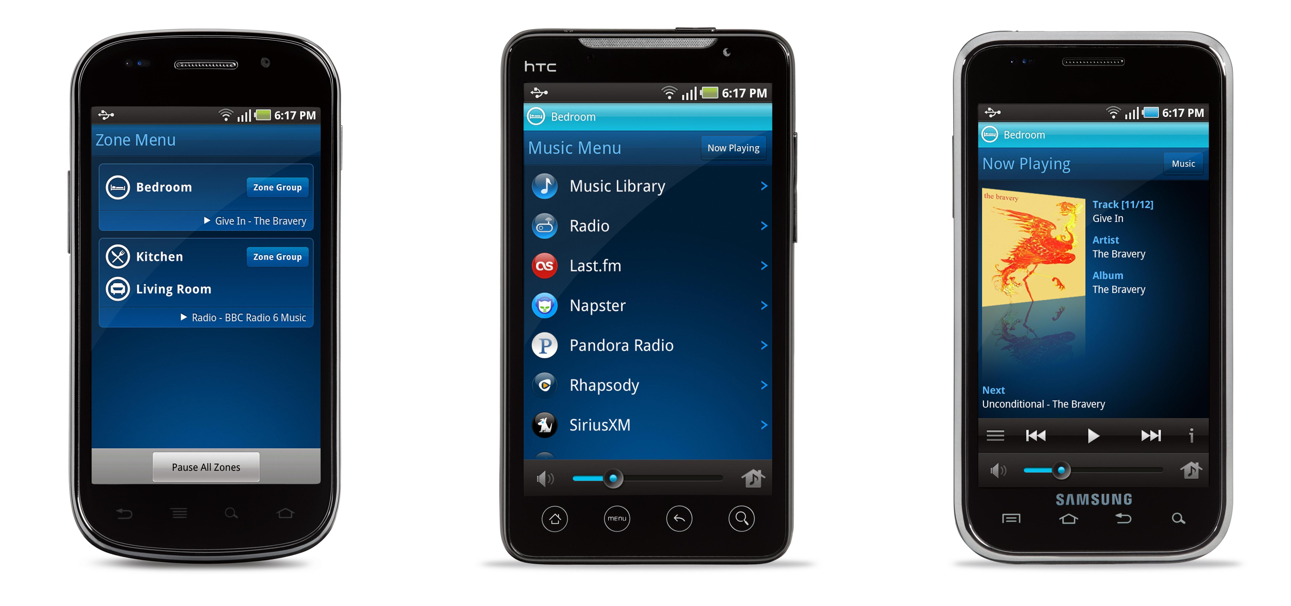
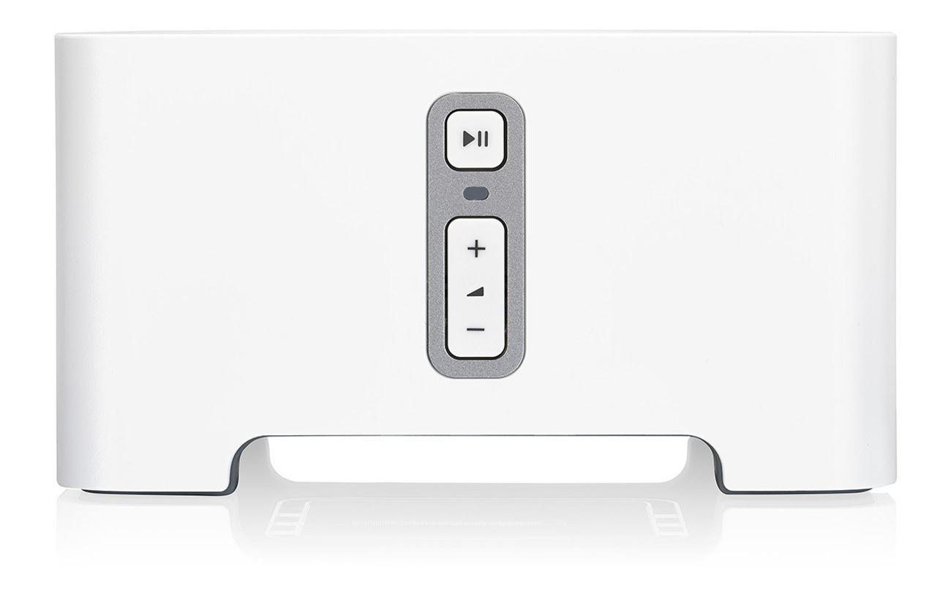
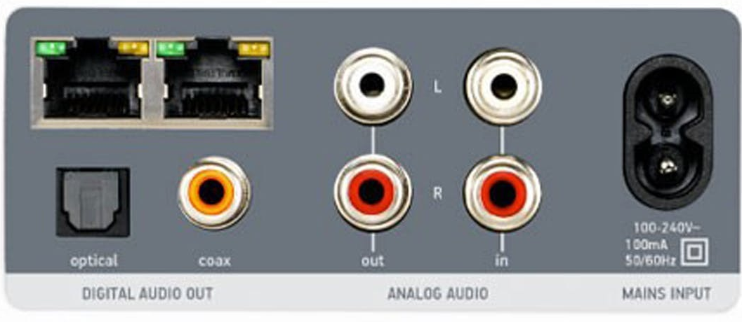
Sonos as an External Source
Sonos Connect
Zone in
Global in
Analog
Optical
Automatic switching
Phone app
Operation remains identical
Deezer and Tidal
High Def not yet available on the Echo
Notes:
Adding Sonos to the system is incredibly simple. First choose a connection path that suits the client. A Sonos Connect offers both analog and optical outputs. The analog output can be used for either the single zone or global input. The optical output can only be used with the Global SPDIF Optical input. When using either Global input, select which zones will have access to the Sonos Connect. This can be from 1-4 zones. Remember, if the Global input is selected for a particular zone, the individual zone input cannot be accessed. It is an either/or selection. When the Echo DOT is not in operation in a particular zone, Valet will automatically default to the selected external source for that zone, in this case, the Sonos Connect. Operation of the Sonos system through the phone app will be exactly the same as the user has experienced in the past. However, switching over to the DOT and its native streaming services is as simple as asking Alexa to play a desired track or artist. Valet will instantly switch to the DOT’s audio output and begin playback. This seamless interaction allows the user access to both sources at will.
Just recently the Amazon announced it has added the streaming service Deezer+ to it’s offering of supported services. However, if a client requires a high-definition source like Deezer HiFi or Tidal, this may be another reason to implement Sonos as an external source.

Slide 25


Margins Matter
Yamaha Music Cast (31%)
Denon Heos (40%)
Sonos (25-30%)
Valet (50%)
Speakers (62%)
Notes:
Not only will you be offering a customer an advanced, high-fidelity, voice controlled music system, you will also be making money in the process. Due to their mass market approach and limited concern for your well being, these systems simply do not offer the profitability you can achieve with the Valet system. As they average between 25 and 40%, you can double the margin with Origin and provide a better solution.

Slide 26
Advanced System
Individual Zone Loop Out
Additional Amplification
Outdoor applications
Subwoofer
Hardwire additional Valet amplifiers
Stacking Valet for more zones
DOT only
Full functionality
Zone grouping
External sources
Various wiring configurations
Notes:
Let’s look again at the various bussing configurations that are available to increase the Valet system’s flexibility. One application is when you want to have the zone closest to the backyard control the outdoor landscape system. Connect the loop out from that zone to the Origin DSP3-700 amplifier and either the audio from the DOT or a connected external source is now distributed throughout the outdoor system.
The loop out can also be used as a hardwire connection to additional Valet amplifiers. Although this is not a common connection, it is one of the available options.
Speaking of stacking multiple Valet amplifiers, if you want to increase the number of zones, there are a several configuration options. Simply stacking multiple units and relying exclusively on the DOTs as your audio source is an excellent way to expand the system. No hardwire connections between the amplifiers are necessary as each DOT in each zone acts independently. DOTs can be grouped and they will respond as a single unit for “party” scenarios. When you add external sources to the mix a hardwired connection is necessary for the two amplifiers to share the same source. This could be from a single loop out to a single zone in on the second Valet if sharing in only one zone is desired. It is also possible to come from a single loop out into the Global analog input of the second amplifier, at which time that source is available in every zone that is switched to “Global” as the external source. This could be one two, three or all four zones. Remember, the external source is only going to play when the DOT in that zone is inactive.
Although it is best if there is adequate physical separation between DOT’s to avoid multiple DOTs attempting to respond to the same command. This challenge is usually mitigated by the fact that the multi-microphone array and internal software do a great job of having the DOT closest to your position respond to you.

Slide 27



Interfacing With Control Systems
12v Trigger
Programming execution
Monitor status
Notes:
Those of you that offer one of the major control and automation systems will find that Valet can be a valuable addition. The 12-volt triggers in each zone can be used to trigger an event or an entire macro in a Control 4, Savant or Crestron system. In a recent installation in Texas, the Valet triggered a C4 system as soon as Alexa was addressed and displayed a DOT image on the keypad indicating the DOT was currently the source. It was also able to pause the TV in one of the bedrooms where the Valet was using the TV audio as an external source. Anytime Alexa was asked a question, the TV would pause until the interaction was completed and then unpause and continue the program. More advanced commands will become part of the system as dealers explore additional scenarios in which Valet and their control system of choice need to interface.

Slide 28
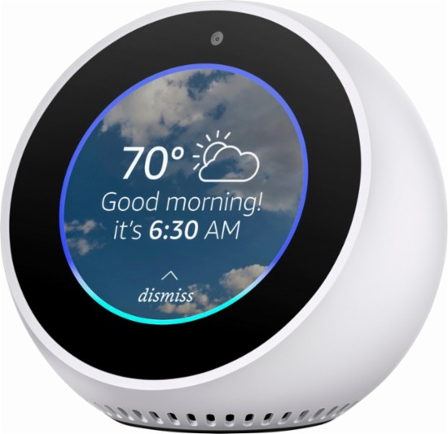
Echo Spot
The video advantage
Small desktop video display
Integrate seamlessly with DOTs
Ring doorbell interface
Video calls
Notes:
As the Echo platform continues to advance, Valet grows in both capability and functionality. The new Echo spot features a small round video display and a camera that add visual elements to the Echo experience. With Amazon’s acquisition of the Ring Doorbell, the Spot sets on a nightstand, end table or countertop and allows the user to answer the doorbell and view and interact with the person ringing it. The same goes for video calls to friends and family. Once again, the audio is playing through the speakers in the room and the Spot acts as the microphone and the video camera.

Slide 29
What Are We Creating?
The End Result
Notes:
After seeing the details of the system, what is it we are trying to accomplish?

Slide 30

Jarvis
This is the experience we are delivering
Notes:
When Tony Stark walks into his home and begins to request various things of Jarvis, his AI powered assistant, the experience is very natural and undeniably impressive. This is the desired outcome of a Valet/DOT system. Selecting an artist, album or playlist for playback while turning on the lights and adjusting the A/C is just the beginning of what this system can offer.

Slide 31

Speakers
Echo Dot
Notes:
All of this happens with a very discrete visual presence. The speakers and the DOT hidden away but instantly accessible on demand.

Slide 32
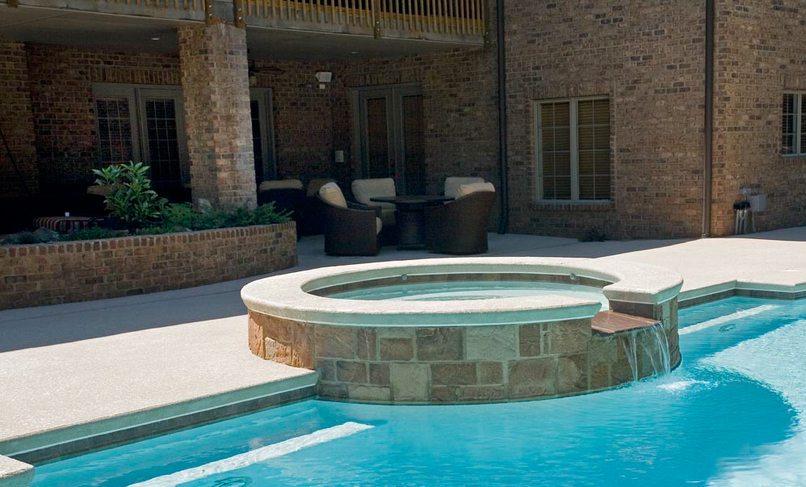
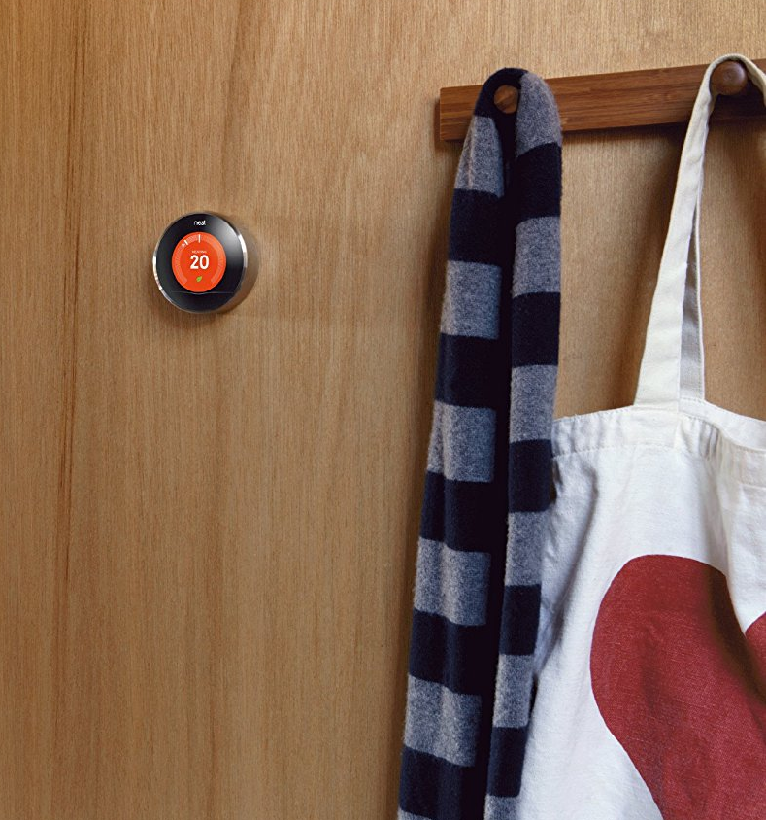
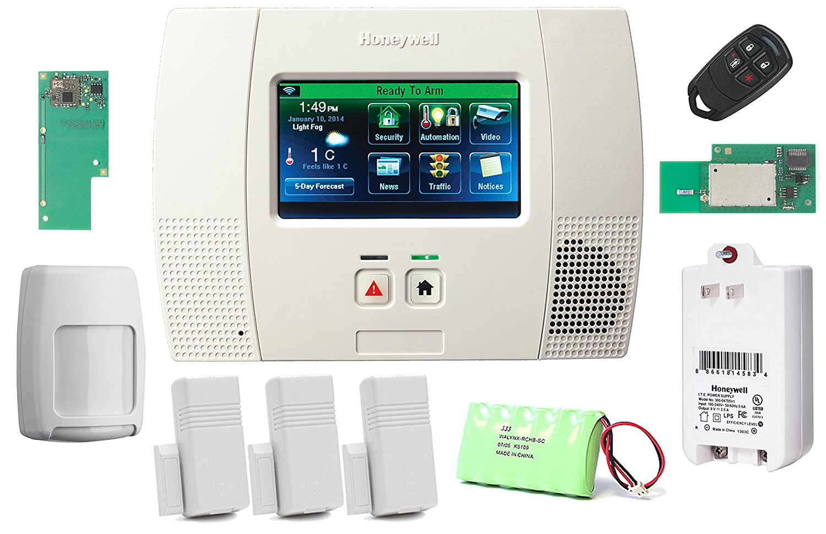
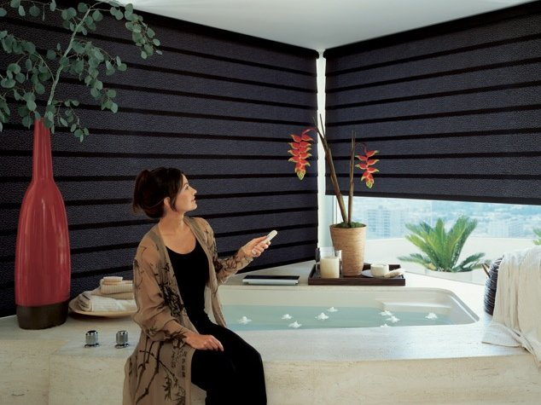
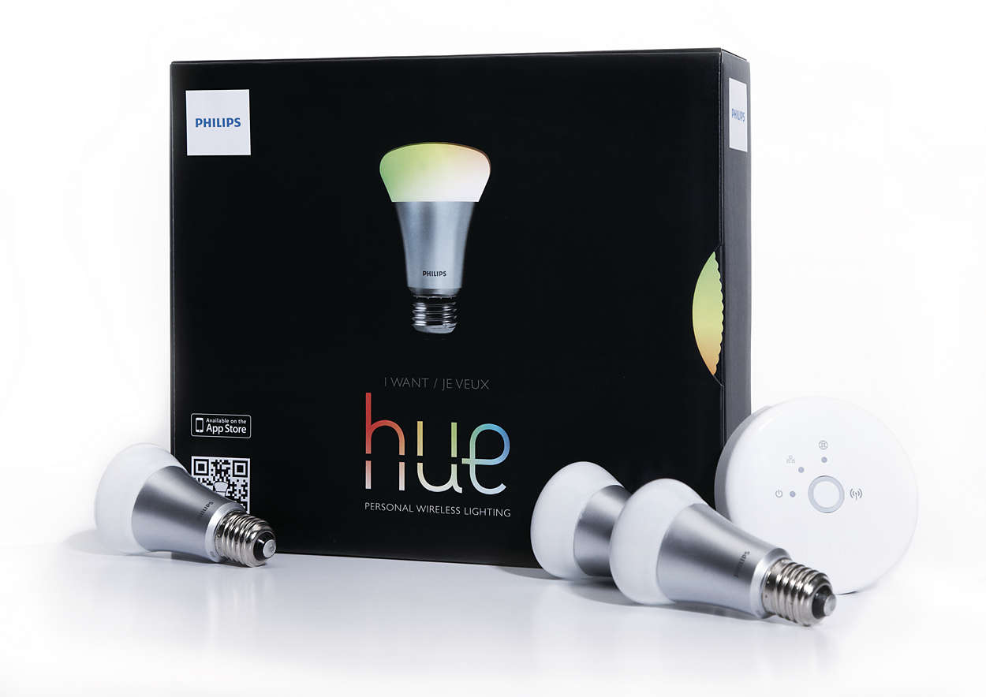
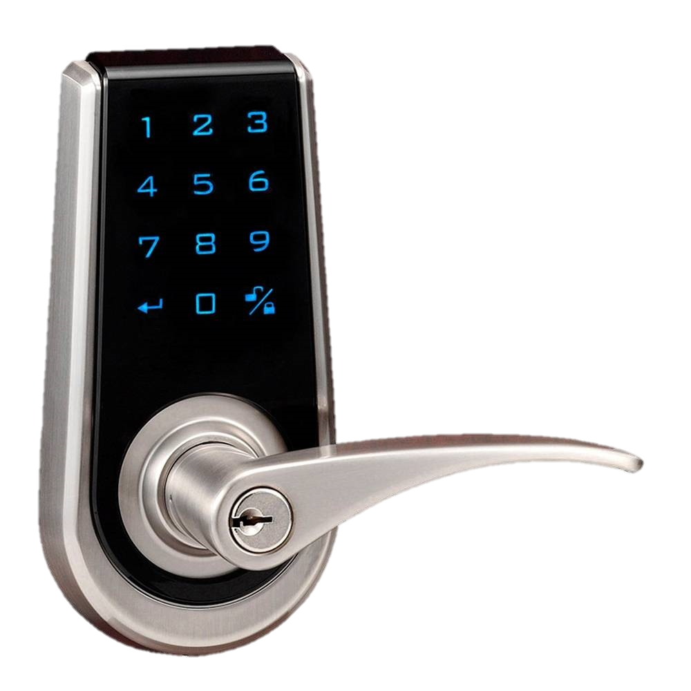
Notes:
Should you choose to take advantage of the thousands of skills available for the DOT, an entire voice controlled automation system is possible. We simply offer you the opportunity with music distribution as the calling card. Where you take it from there, is completely up to you.

Slide 33
Valet Advanced
Why, What and How

Slide 34


