Slide 1


Slide 2
Behave!

Slide 3


Changing Behavior

Slide 4

Start With Why

Slide 5
The Golden Circle

Slide 6

The Golden Circle
WHY
HOW
WHAT

Slide 7
The Golden Circle
People and companies know what they do
Some know how they do it
Most don’t know why they do it
WHY
HOW
WHAT

Slide 8

WHAT - We make great computers
HOW - They’re beautifully designed, simple to use and user friendly
You wanna buy one?

Slide 9

WHY- Everything we do, we believe in challenging the status quo. We believe in thinking differently.
How - The way we challenge the status quo is by making our products beautifully designed, simple to use and user-friendly
What - We happen to make great computers
Wanna buy one?

Slide 10
iPod
Mp3 player
Developed by Creative Technology
Advertised as a “5GB mp3 player”
iPod
Introduced 22 months later
Advertised as “1,000 songs in your pocket”
Wanna buy one?

Slide 11
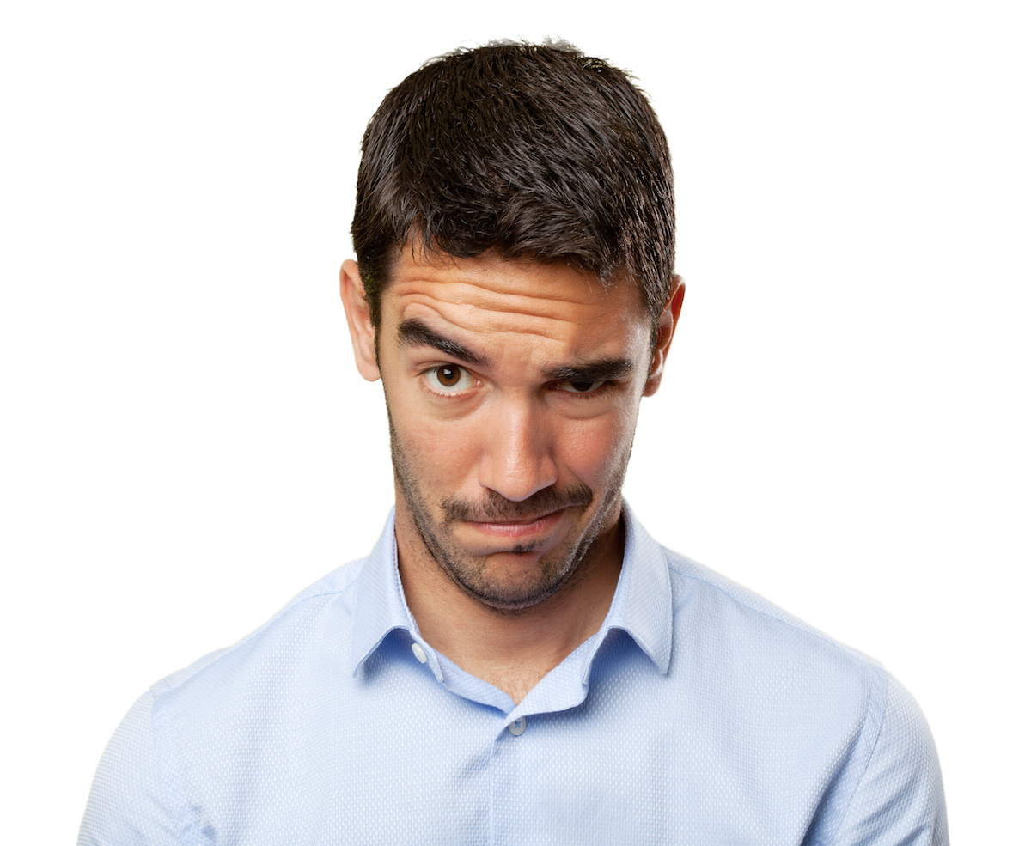

Your Own Behavior
WHAT - I want to get more accomplished everyday
HOW - Get up earlier, plan better, work smarter
WHY - To make more money

Slide 12

Your Own Behavior
WHY- I want to feel incredible self worth
HOW - Accomplish more everyday
WHAT - Get up early, plan better, work smarter
The Result:
More Opportunities
More Personal Satisfaction
More money

Slide 13
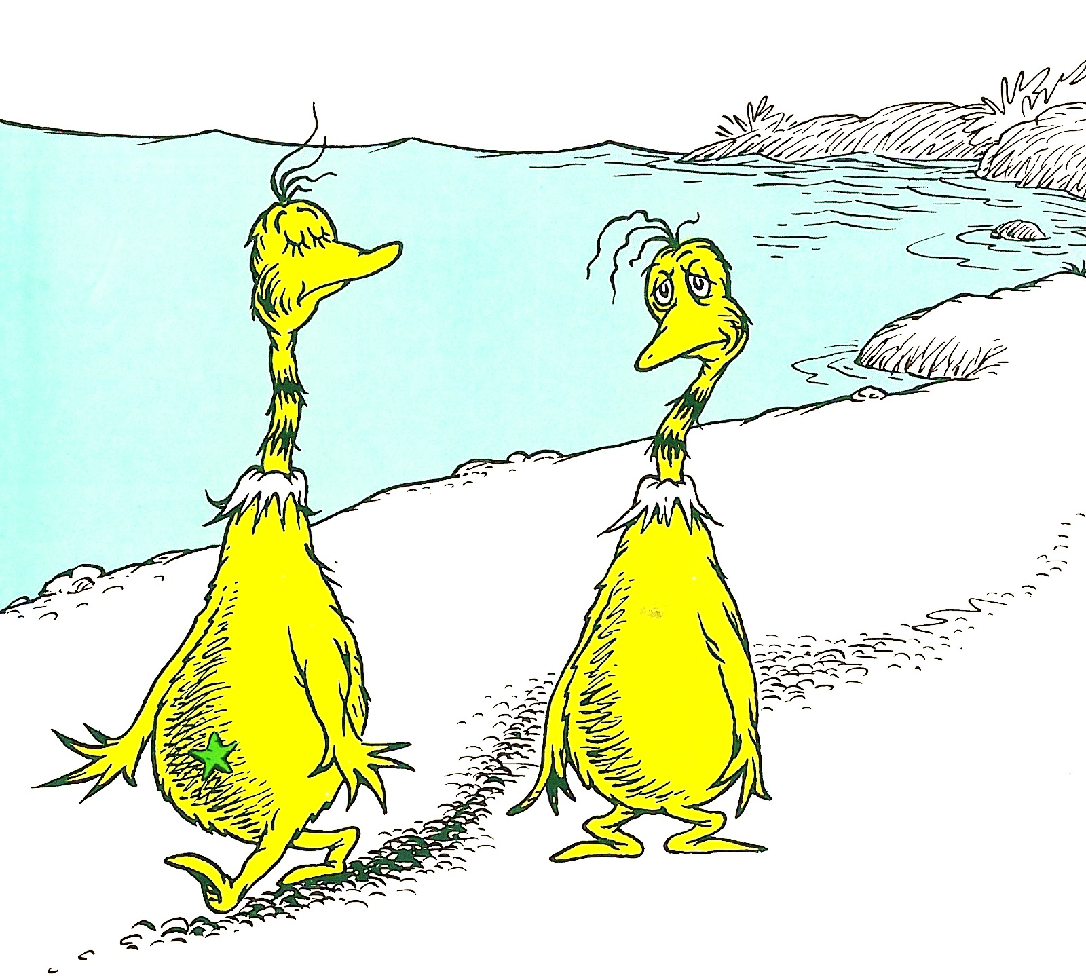
This is Not Opinion, This is Biology

Slide 14
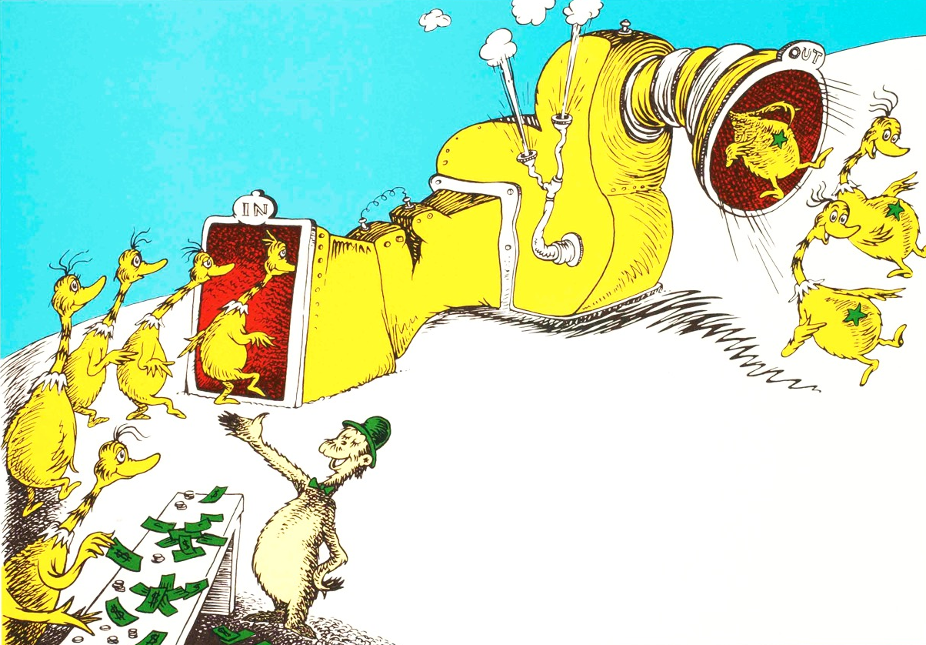
This is Not Opinion, This is Biology
Sylvester McMonkey McBean

Slide 15

The Brain
LIMBIC BRAIN
WHY
HOW
NEOCORTEX
WHAT

Slide 16


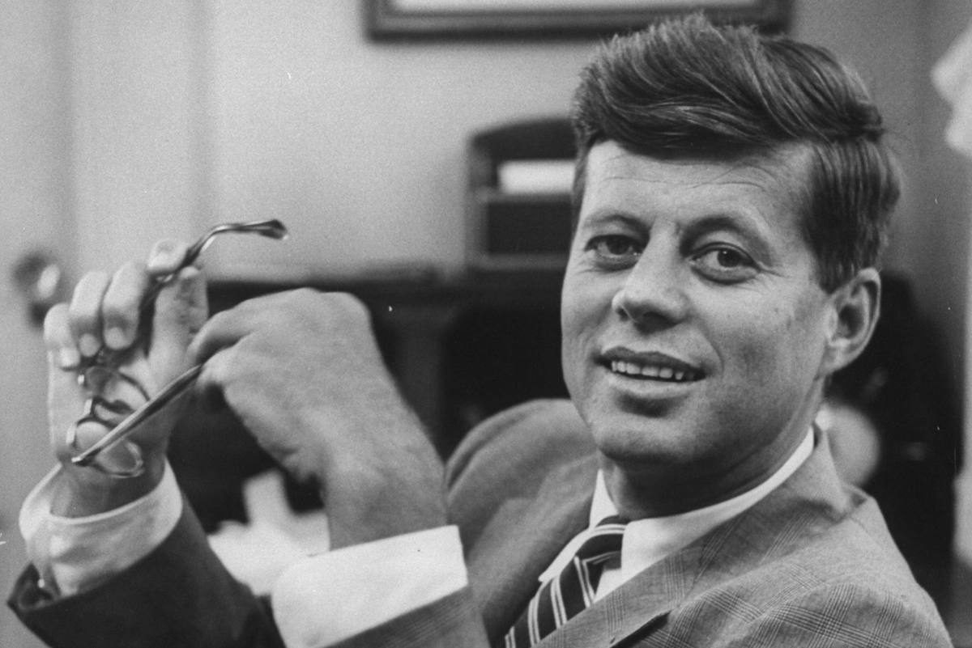
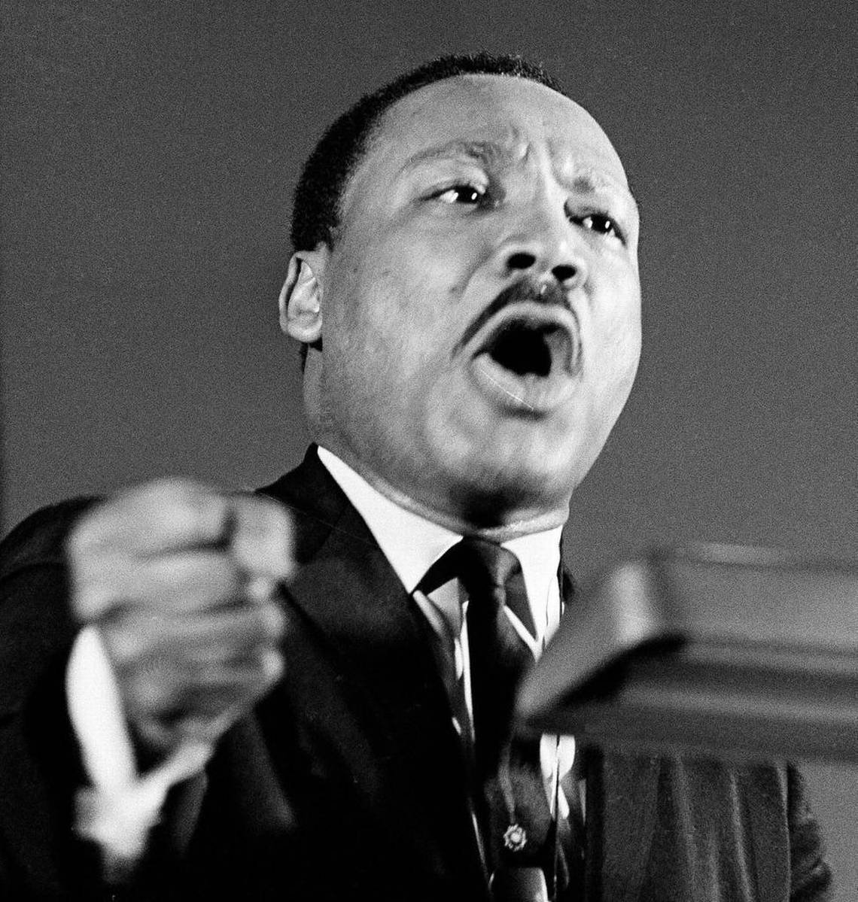
Disproportionate Achievement

Slide 17
WHY?
To Be Happier

Slide 18
Happiness is a Choice It’s completely up to you

Slide 19
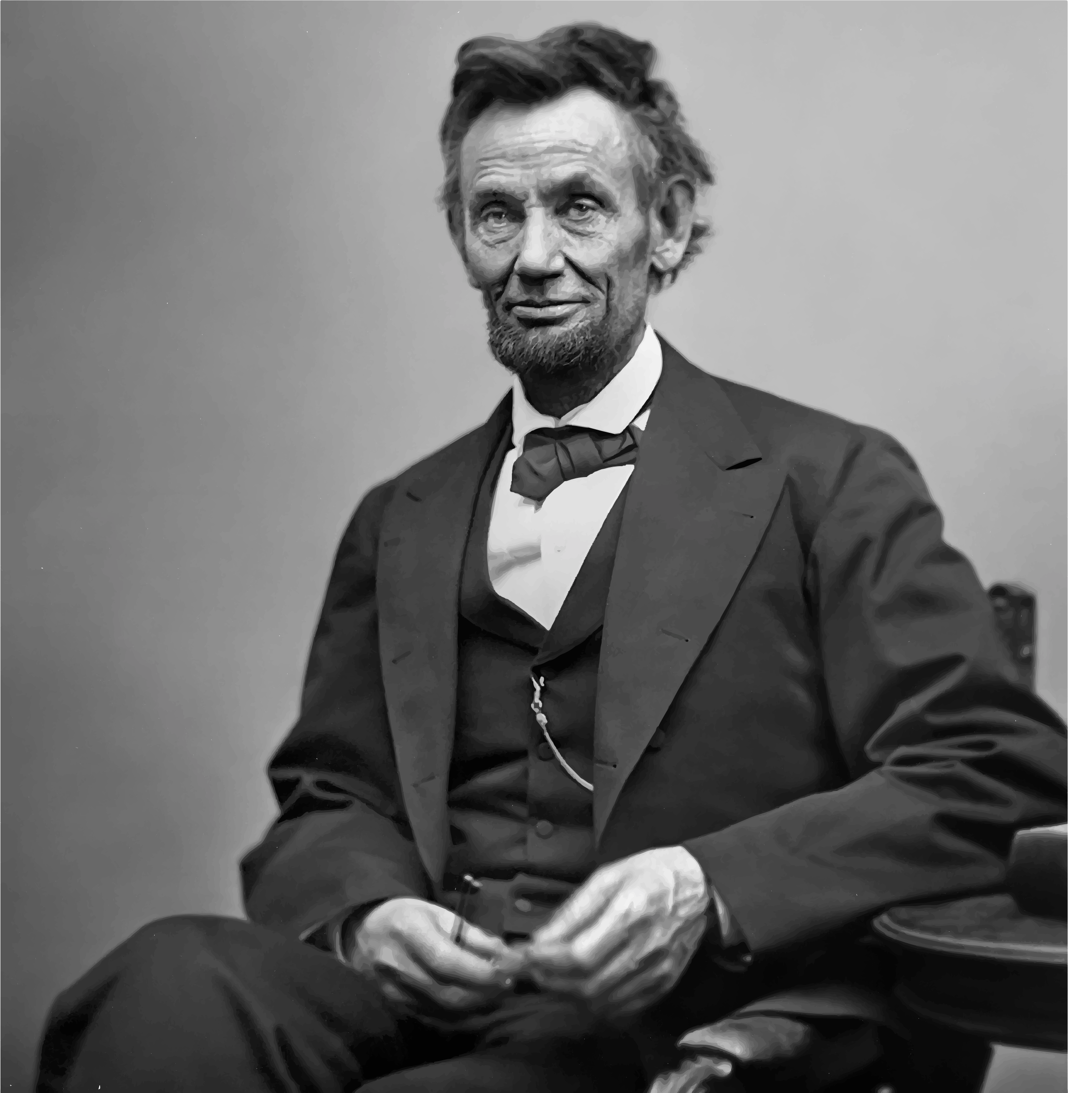
“Folks are usually about as happy as they make their minds up to be.”
Abraham Lincoln

Slide 20
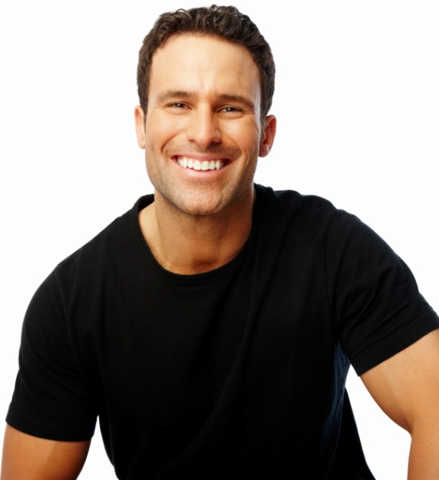
Happiness as an Attribute
Happy people encourage happiness in others
You learn more from interaction with others than from any book, class, seminar or lecture
Happy people draw people to them
More people, more knowledge
More knowledge, more opportunity
More opportunity, more chances for success

Slide 21
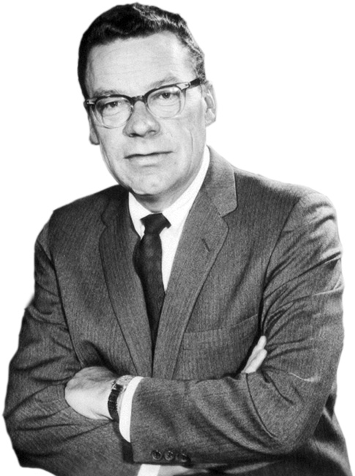
“You become, what you think about.”
The Strangest Secret
Earl Nightingale

Slide 22

The Power of Thought
Choose what you think about
Think about it

Slide 23

Getting What You Want
Discover what you want
Determine the price
Get busy paying it

Slide 24
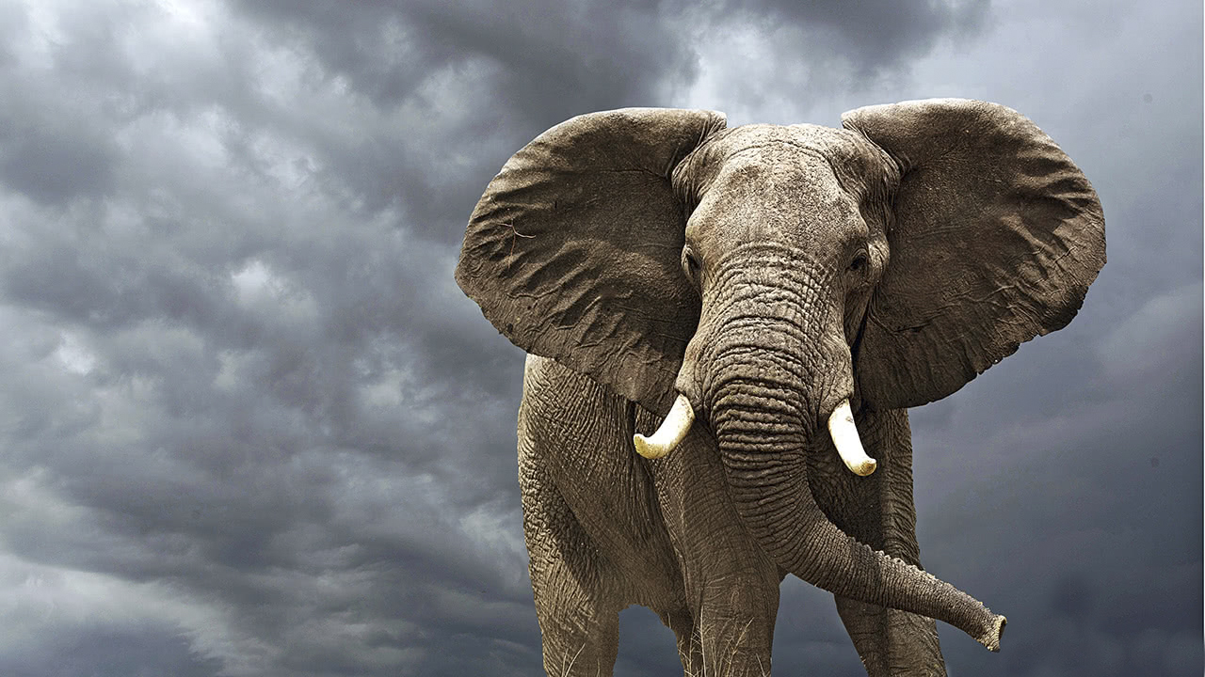
Bite-sized Chunks
Small steps
Check it off
Glance back
On a roll
Celebrate your victories

Slide 25

The Blessings of Gratitude

Slide 26

The Blessings of Gratitude
What are you grateful for?
People
Experiences
Bad times
Never too small
“Thank you!”

